Slide 1

PrimeHub
Effortless Deep Learning Nexus
hi@primehub.io

Slide 2

Outline
道
Purpose & Mission
Market & Competition
Landscape & Early Adopters
Team & Leadership
Shareholder & Culture
Q&A
天
地
將
法

Slide 3
Mission
Help industry-wide AI Adoption

Slide 4
Problems
Setup machine learning environment is hard. It is even harder to manage resources/quota/data/access control
Reproducible researches require lots of tooling
It may take lots of time (months) to apply AI/ML research result in production.

Slide 5
Solutions
One-click to GPU research environment access within 20 seconds.
Manage team resources quota, data access control. On-Prem, Cloud, or Hybrid cloud.
Versioned, reproducible training runs.

Slide 6
Solutions
Niche: On-prem / Cloud (Subscription & Support)
PaaS: invidivual, smaller team, integrators

Slide 7
Product Roadmap
Data adapters
Switch between CPU/GPU mode
Next Phase: data scientist paradgim tooling: ML model to testable, deployable API.
Next Phase: Code-to-Data infrastructure for institutions to bring in outside consultants or AI products on internal data

Slide 8
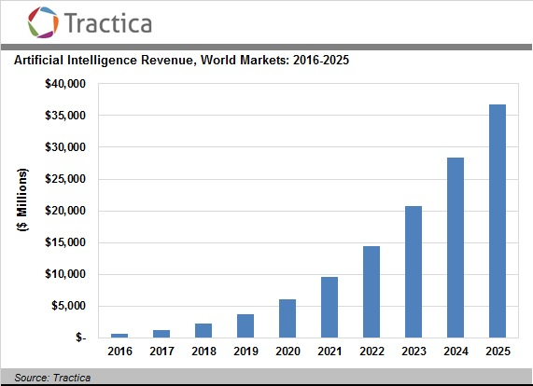
Market (Global)

Slide 9
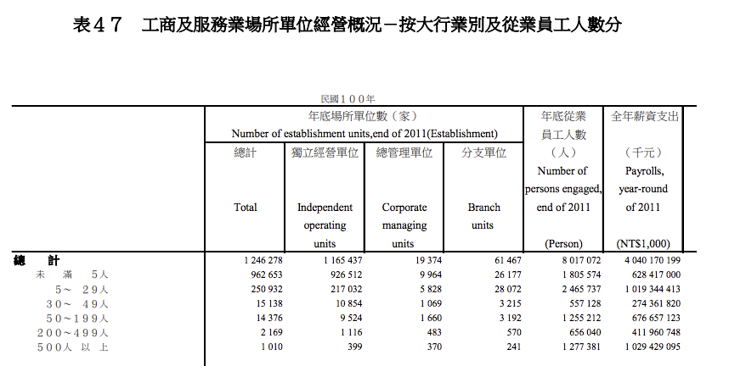
Market (TW)
15k * 30% AI adoption = 4.5k
50k investment in AI infrastructure software/labor: 225m USD

Slide 10
Competition
Convenience
PrimeHub
TinyMind
FloydHub
CoCalc
Paperspace
Cost
Google
private cloud
Azure
AWS

Slide 11

Early Adopters

Slide 12

Early Adopters

Slide 13
Early Adopters
Traction: 3000+ industry pupils from AI academy (incl branche) per year
in talks: 2 banks, 1 vertical integrator
in-bound reaches: 2 hardware vendors
BFSI & Telecom: Requires on-prem data

Slide 14
Potential Customers
Banking, Financial Services & Insurance (BSFI)
Healthcare
Advertising & Media
GPU server manufacturer/distributor

Slide 15


Team
高嘉良 clkao
Co-founder of g0v
Board Member, III
Board Member, Open Culture Foundation
薛良斌 hlb
Co-founder of Handlino Inc.
Former Director of KKTIX, KKBOX
Director of cacaFly
Tech & Strategy
Operations & Sales

Slide 16
Team
H2 2018
2-3 developers/devops
H1 2019
4-5 developers/devops
1-2 support
1-2 sales/solution specialist

Slide 17
Shareholder Structure
Founders to setup closely-held company (no par stock) with TW$2m initial capital (June 2018)
Seed funding: TW$15-18m (July 2018)
Goal: 10% (anti-dilution) in Series A
Legal document to be drafted, depending on using preferred shares or convertible
Quartly updates

Slide 18
Anti-dilution
Goal: Seed shares to have 10% (anti-dilution) post Series A
Deloitte: just use common share + civil contracts
preferred shares conversion rate based on Capital
convertible notes

Slide 19
Culture
Fully Remote. Expecting 1st intl hire within 6month
Holacracy & Open Company: http://open.buffer.com/

Slide 20
Thank You
hi@primehub.io

Slide 21
Appendix

Slide 22
Pricing
(TW$) *tentative
 | Single-Node | First 5 Nodes | Extra Nodes
Initial Install - 6-month Support - 8hr Training | 800,000 | 1,500,000 | 30,000 / node
Renewal Standard Support (1 year) | 250,000 | 450,000 | 20,000 / node
Add-ons |  | Notes
Account & Billing Module | 500,000
Hybrid Cloud | 300,000 / provider | GCP/AWS/Azure

Slide 23
PrimeHub architecture
Identity & Authorization Management
User Research Notebook
User Research Notebook
persistent user data
per-Team data
Image Management
Production Prediction Endpoint
Team Data Management
JupyterHub
Training Jobs
Kubernetes Cluster
Network Policy
Distributed Storage
GPU Scheduling

Slide 24
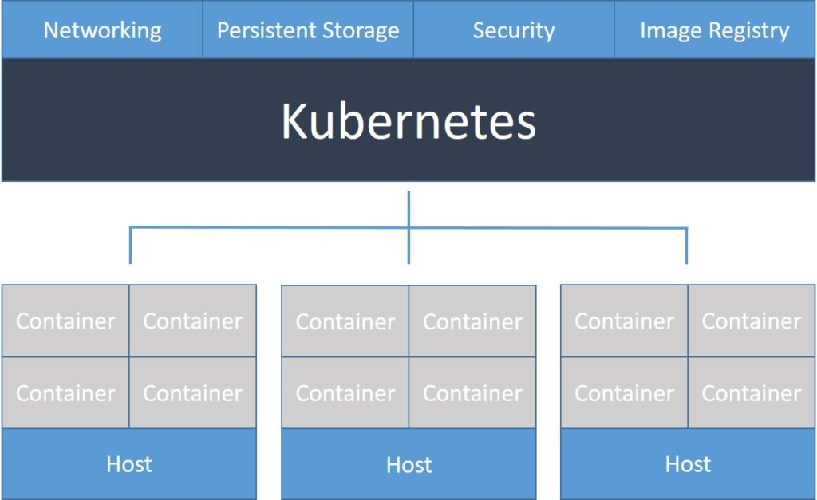
Kubernetes Cluster
Network Policy
Distributed Storage
GPU Scheduling

Slide 25
SSO, 2FA, Team Quota settings, Role-based Team permission
Identity & Authorization Management
SSO Federated from:
LDAP Server
AD Server
github/google accounts
Image Management
Authorization & Quota
Can Team A members use GPU?
Team B can allocate up to 5 GPU
Team Data Management
Kubernetes Cluster
Network Policy
Distributed Storage
GPU Scheduling

Slide 26
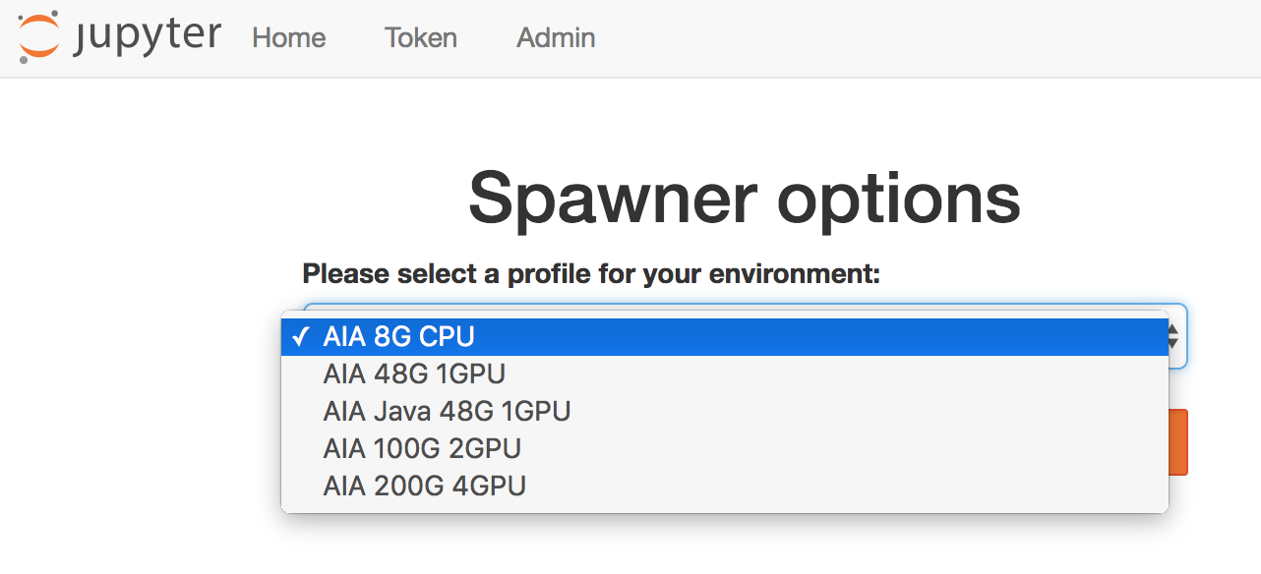
Reproducible Environment, Customized & Audited
Identity & Authorization Management
Image Management
Team Data Management
Kubernetes Cluster
Network Policy
Distributed Storage
GPU Scheduling

Slide 27
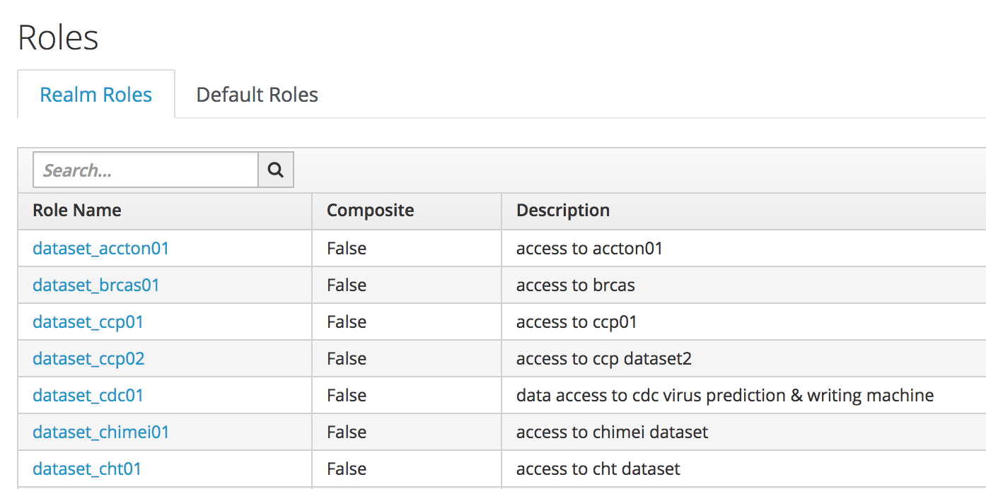
Identity & Authorization Management
Upload and Configure Data Access Policies
What datasets are visible to Team A?
Image Management
Team Data Management
Kubernetes Cluster
Network Policy
Distributed Storage
GPU Scheduling

Slide 28
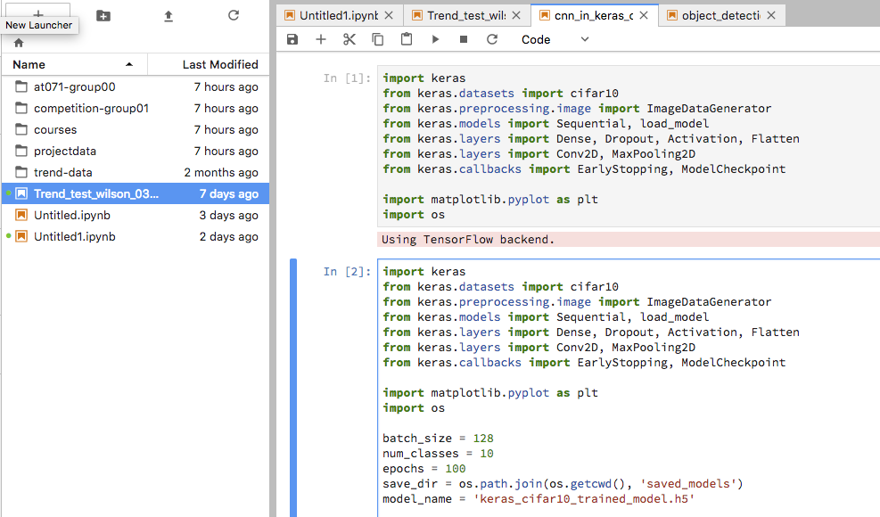
User Research Notebooks
Get GPU evironment in 20s
Interactive Research Environment
Share with Team
Horizontally Scalable
Hybrid Cloud Integration
Kubernetes Cluster
Network Policy
Distributed Storage
GPU Scheduling

Slide 29
Identity & Authorization Management
User Research Notebook
User Research Notebook
persistent user data
per-Team data
Image Management
Production Prediction Endpoint
Team Data Management
JupyterHub
Training Jobs
Kubernetes Cluster
Network Policy
Distributed Storage
GPU Scheduling

Slide 30
Identity & Authorization Management
Image Management
Databoard & Monitoring
Team Data Management
Billing & Accounting Module
Kubernetes Cluster
Network Policy
Distributed Storage
GPU Scheduling

